Slide 1
AP PROJECT TITLE: COLOR SWITCH
DEVELOPED BY: MOHIT BHAR (2109256) mohit19256@iiitd.ac.in
MEET MODI (2019435) meet19435@iiitd.ac.in

Slide 2
Brief Introduction to the Game
ABOUT THE GAME
Colour Switch is mini Game that has Multi-coloured geometric shapes and player used the #W# key to bounce the ball upward through the shape’s matching colours. The score is increased when player collects a star.
After the player hits an obstacle with different colour, it leads to the end of game but the player can use the stars collected to respawn the ball and it would lead to deduction of the score. It also has colour switcher which changes the colour of the ball randomly.
It also has Save game option which can be used to save the current game and can be loaded from the main menu. It helps to save the user progress. User can also restart the Game with the option provided.
HOW TO PLAY
The Game is very easy to play and with simple understanding it can be grasped.
The W key on the key board is used to keep the ball afloat and failure to do so might result in ball colliding with the obstacle or hitting the boundary of the Game. In either case the game is Over.
The pause menu in the Game has resume game, save game and exit to main menu option.
Game over screen has restart game, continue using stars, and exit option.
These buttons has respective functions as the name suggests

Slide 3
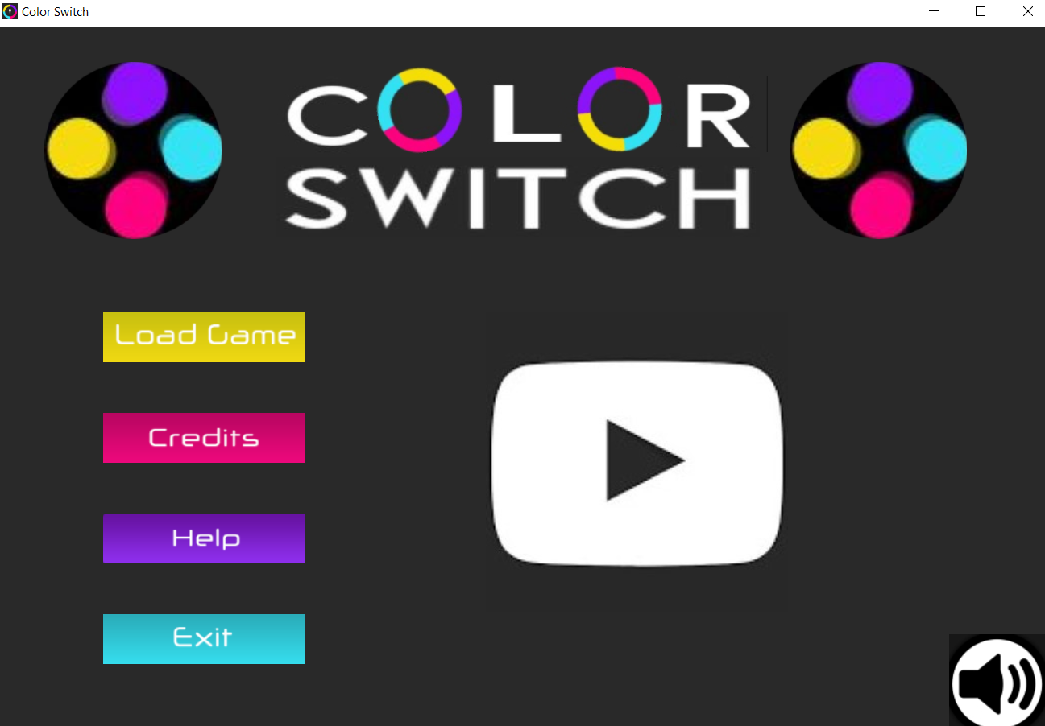
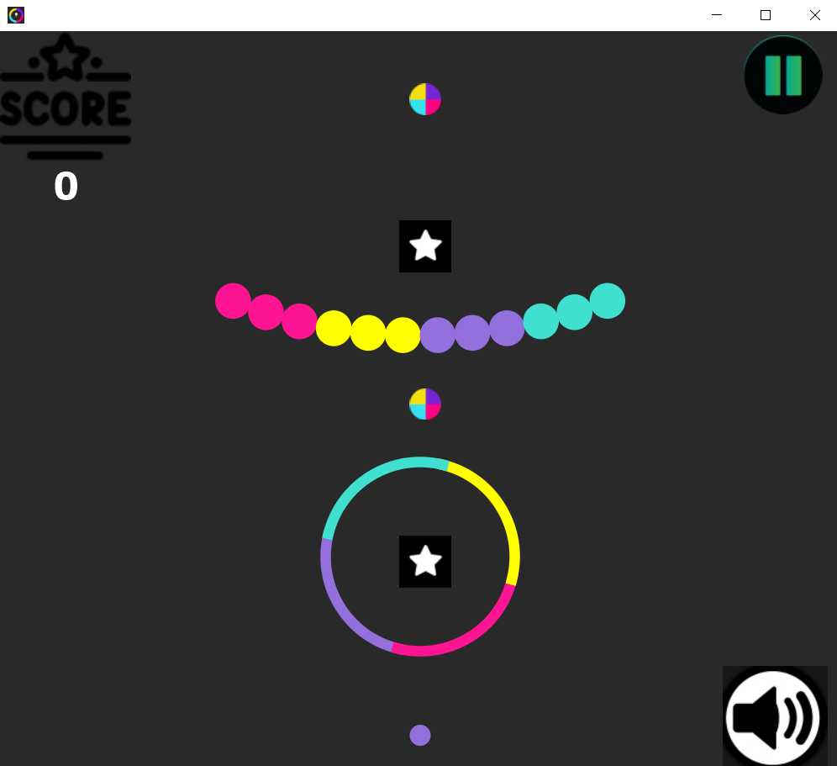
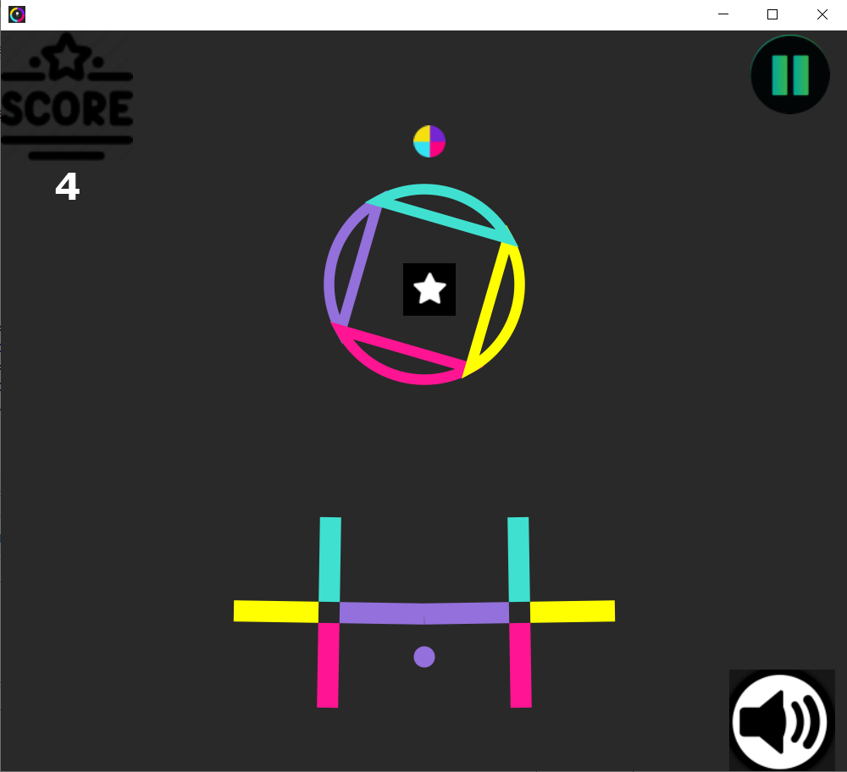
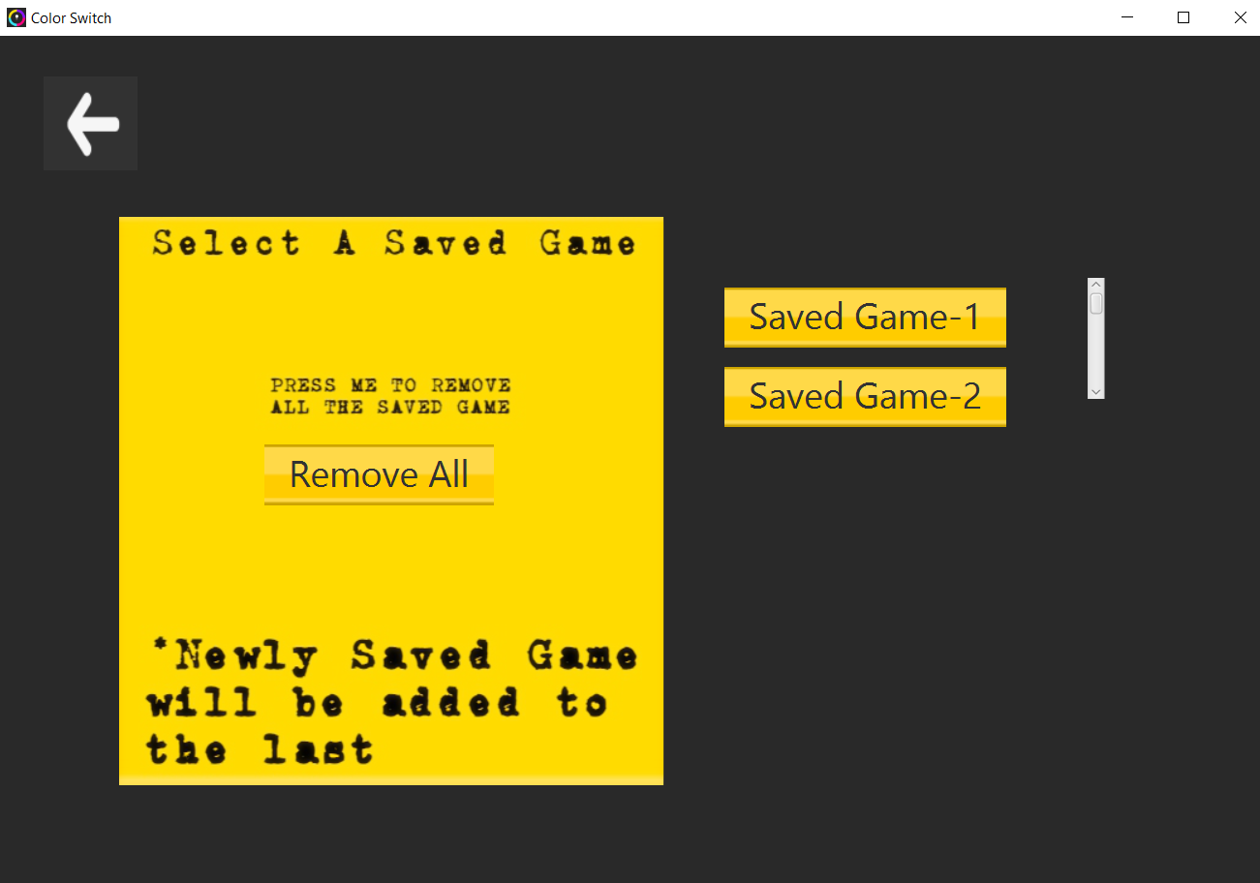
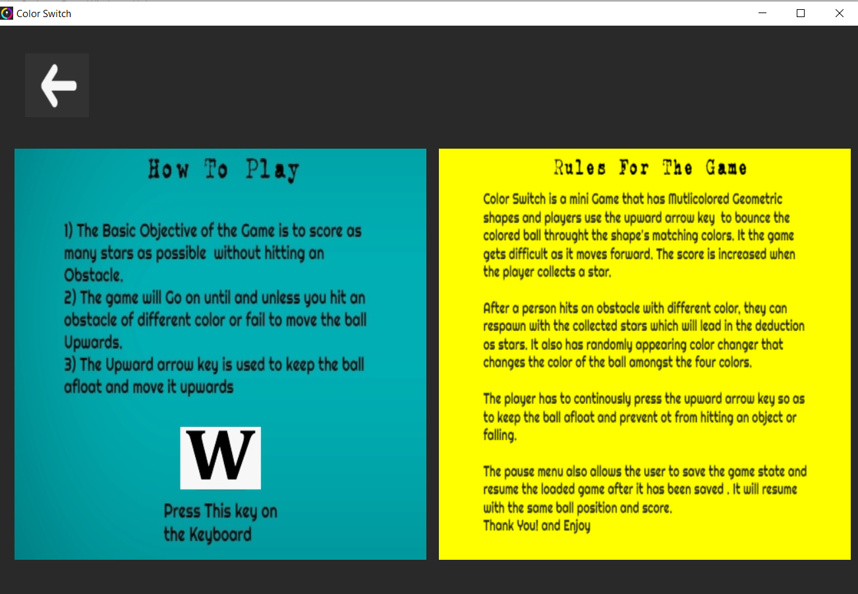
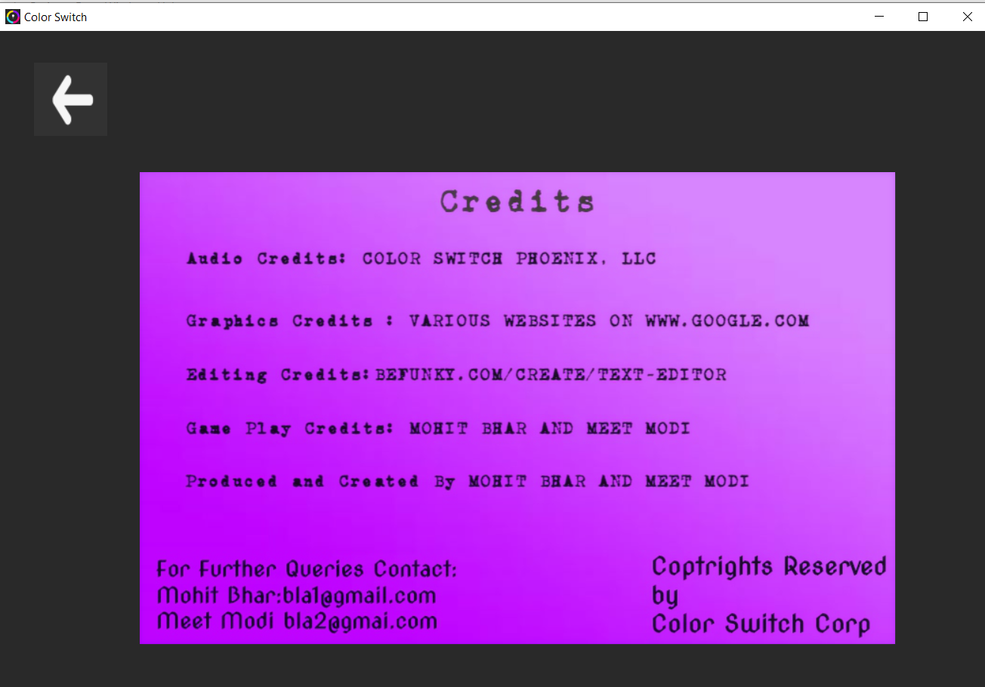
Glimpse of the Game

Slide 4
Contribution of Each Partner
Deadline 1: Mohit Bhar : Major Portion of the Class Diagram and Minor Portion in Use Case Diagram
Meet Modi : Major Portion of the Use Case Diagram and Minor Portion in Class Diagram
Deadline 2: Mohit Bhar: Main screen functionalities like transitions from one screen to another in different options like load game, credits, help section and exit function. Also added Images and some graphics. The in Game pause menu and its functionality. In game collision menu and its functionality.
Meet Modi : The logo for colour Switch and its rotation, Musical effects, play game button transitions. After the transition from
Main Menu creation of different objects in Game Screen like obstacles, score, stars, colour switcher and their movement and collision. Updating the score.
Deadline 3: Mohit Bhar: Creating different or 5-6 kinds of obstacles and adding collision function to some obstacles. Adding functionality to different buttons in subscenes of Pause and Collision screen like continue using stars, restart, resume etc. Serialization and Deserialization of state class. Contribution in bonus component of invincible mode in infinite mode.
Meet Modi : Adding the Collision function to some obstacles. Movement of Game screen i.e. obstacles and different objects on Screen like stars colour switcher. Creation of buttons in load game screen corresponding to different save class and remove all button and its functionality. Bonus Component like the invincible mode after colliding with golden ball.

Slide 5
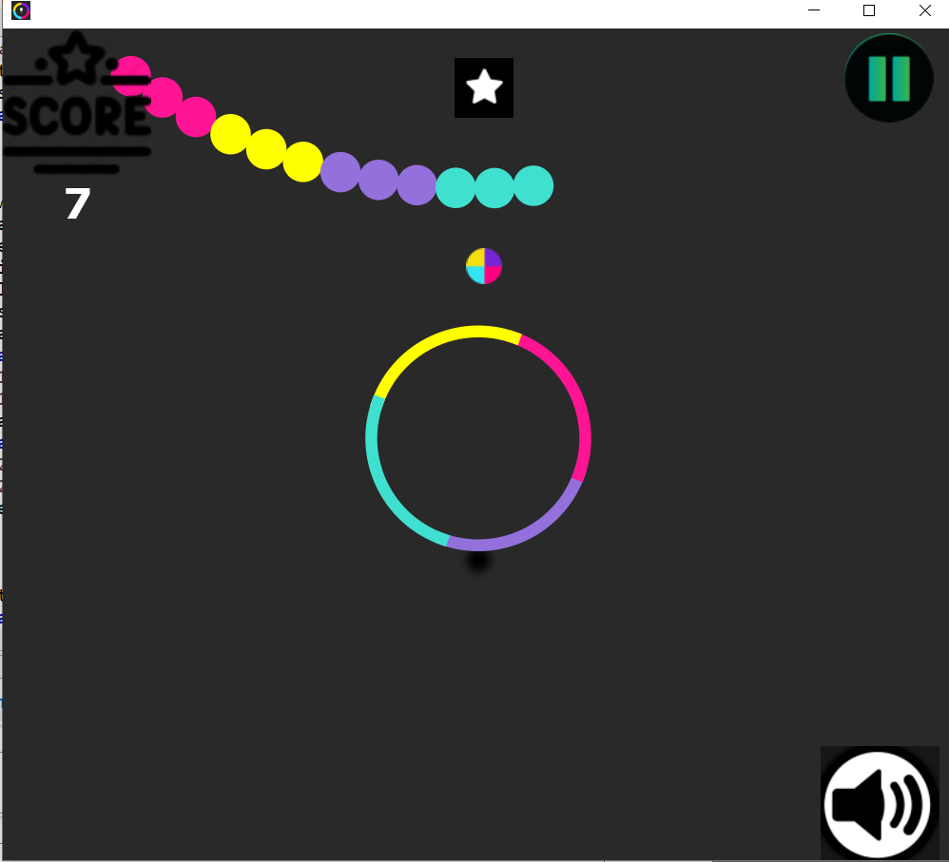
BONUS COMPONENT IN GAME
The Bonus Component in Games are
The invincible mode in infinite classic game in which collection of a golden ball results in making the ball invincible and allows it to pass through any obstacle without colliding for a duration for few seconds and Increasing Difficulty as the game progresses due to gravity.
The help section, credit section an Main Menu Screen. In the load Game screen, the remove all option which is used to delete all the saved games in a database.
The Background Music in the game which can be muted on the main Screen as well as the In game Screen.
Obstacles greater than the minimum requirement and which were difficult to implement like the pendulum obstacle , the obstacle with 16 balls.

